Slide 1
Grafana Dashboards for Quotas
Version 0
Oct/Nov 2020
Nicholas Ruggiero
UDS Coroporate Advisory Engineer Team

Slide 2
Overview
Background
Isilon Quota Reporting
Retrieving Quota Reports
Influxdb for quotareports
Grafana Dashboards

Slide 3
Background
Issue: Customers want to see quota trending over time
Isilon has the info
It takes a lot of manual work to piece it together
Solution:
Take the quota reports and ingest into a time series DB like Influx, the view using Grafana Dashboards

Slide 4
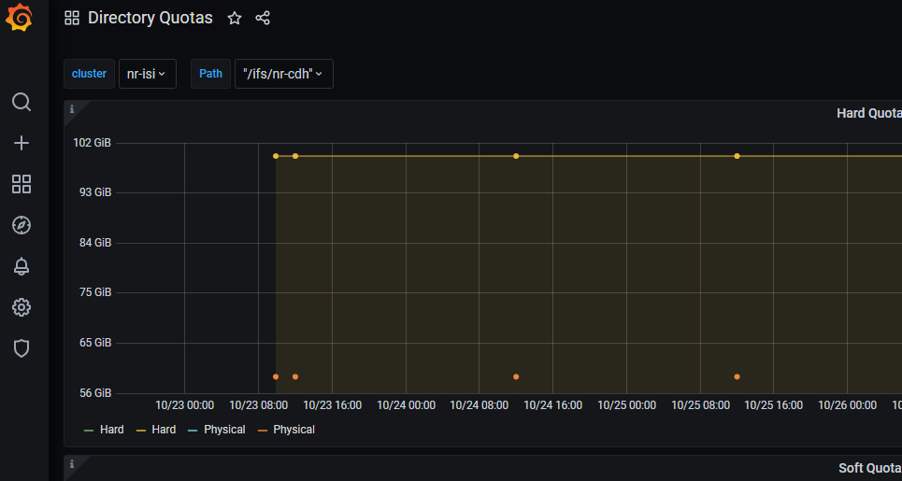

What it looks like
Leverage Grafana for Visualization
Isilon
Grafana
InfluxDB
Feed it to InfluxDB, a Time-Series DB
Get Quota information using Platform API

Slide 5
Isilon Quota Reporting
Isilon quota reporting is done on a “scheduled basis”, this is what will provide the time series for quota trending
There is also a manual feature to generate current results
nr-isi-12# isi quota settings reports view
Schedule: every 1 days at 12:00 PM
Scheduled Dir: /ifs/.isilon/smartquotas/reports
Scheduled Retain: 365
Live Dir: /ifs/.isilon/smartquotas/reports
Live Retain: 40
Organization will be key as you try to decipher all the reports
Access Zone information *does not* show up, but identities are tied to the AZ
Directory quotas are straightforward.
Step 1 – Create the quotas, and create the quota reports schedule that you wish to trend.
Once a day should be sufficient.

Slide 6
Quota Reports (cont.)
Step 2: Download the list of Quota reports on the cluster. (the detail ones)
curl -X GET "https://$isi_ip:8080/platform/1/quota/reports?type=detail" --insecure --basic --user pmon:emc
{
"reports" :
[
{
"generated" : "manual",
"id" : "1493210924-manual-detail",
"time" : 1493210924,
"type" : "detail"
},
{
"generated" : "manual",
"id" : "1493210932-manual-detail",
"time" : 1493210932,
"type" : "detail"
},
Array of reports
Here is where we get the Time from

Slide 7
Quota Detail
Step 3 – Get the quotas and details from each report.
curl "https://10.231.153.162:8080/platform/7/quota/quotas?1493210924-manual-detail" --insecure --basic --user pmon:emc
{
"quotas" :
[
{
"container" : true,
"enforced" : true,
"id" : "FQAvAAEAAAAAAAAAAAAAQAUAAAAAAAAA",
"include_snapshots" : false,
"linked" : false,
"notifications" : "default",
"path" : "/ifs/nr-hdp.oriig",
"persona" : null,
"ready" : true,
"thresholds" :
{
"advisory" : null,
"advisory_exceeded" : false,
"advisory_last_exceeded" : null,
"hard" : 107374182400,
"hard_exceeded" : false,
"hard_last_exceeded" : null,
"percent_advisory" : null,
Array of Quotas in the report
"percent_soft" : null,
"soft" : null,
"soft_exceeded" : false,
"soft_grace" : null,
"soft_last_exceeded" : null
}"thresholds_on" : "physicalsize",
"type" : "directory",
"usage" :
{
"applogical" : 11370554030,
"applogical_ready" : true,
"fslogical" : 11395075031,
"fslogical_ready" : true,
"inodes" : 9767,
"inodes_ready" : true,
"physical" : 17765276672,
"physical_ready" : true
}
},
Juicy Details

Slide 8
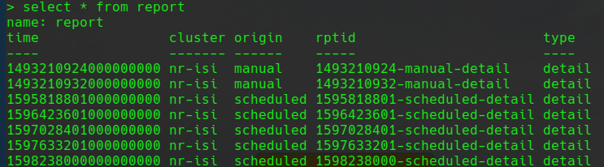
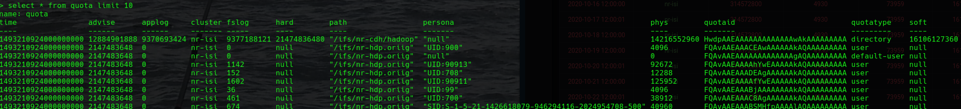
InfluxDB setup
Create a Database “quota_reports”
Two “tables” reports, and quotas
Reports == Quota reports
Quotas = The quota’s detailed info in each report
Add cluster to each.
Create Times for the quotas table from the time of the report.

Slide 9
Grafana Setup
So far 3 Dashboards
1. Quota Reports – simple dashboard that shows which reports fit the time period with a basic filter on ‘quota type’
2. Directory Quotas only
Shows Physical usage for any directory quota
3. User Quotas- use and “ad hoc” filter to pick a “persona” and report on their usage.

Slide 10
To Do
Calculations on quotas
Threshold alerts
Figuring out the Who is …. For personas using the zone info

